Slide 1

Reimbursement Portal
By Gaurav Shrivastava

Slide 2
Introduction
Reimbursement Portal is an online portal where an employee can submit reimbursement claims related to relocation, medical, and office supplies and the assigned manager can approve/reject the claims.
If you're an employee, you can submit reimbursement requests and if you are Managers, log in to review and manage reimbursement requests from your team.

Slide 3
Functional Requirements
Three user types: Admin, Manager, Employee.
Managers and Employees register and login before any operations.
Only company emails are valid for registration.
Users must sign in before any operations.
Employees submit reimbursement requests.
Requests include expense type, amount, date, and one image receipt.
Managers approve/reject requests with comments.
Policy categories: Traveling (15k), Relocation (20k), Tech assets (5k).
Admin assigns managers to employees.

Slide 4
Admin is the default manager until reassigned.
Admin can delete employees and managers no longer in the organization.
Admin can add or delete departments.
New departments appear in the registration dropdown.
One or more managers per department.
Multiple employees under one manager.
Requests directed to managers based on employee's department.
Employees can view their requests, statuses, comments, and history.
Comprehensive audit trail for each request.
Users can upload jpg documents as supporting evidence.

Slide 5
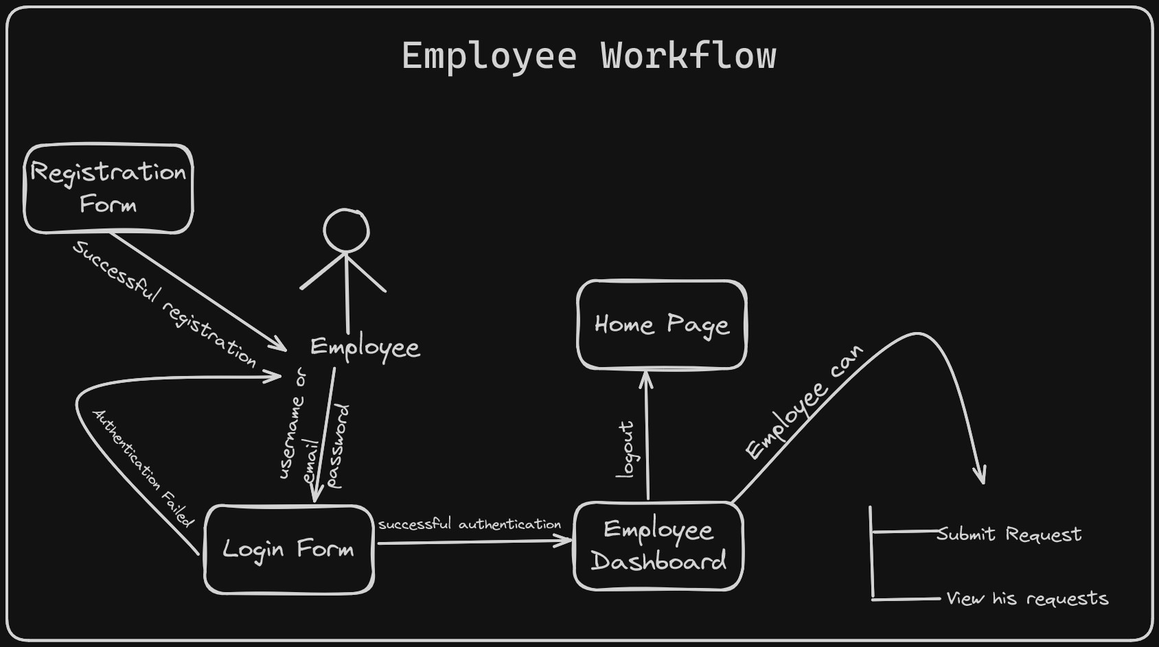

Slide 6
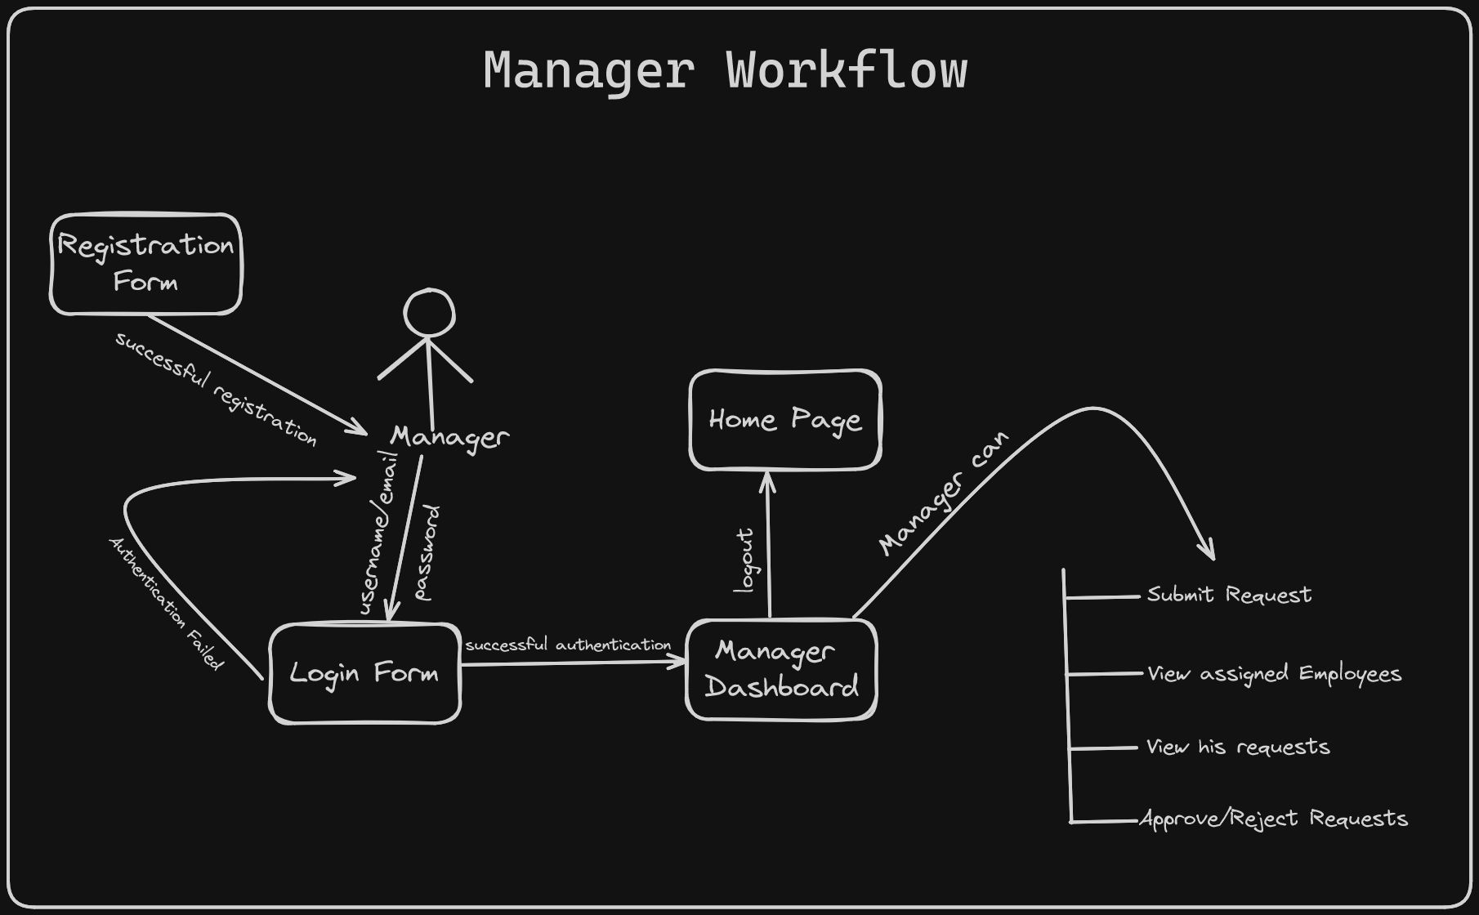

Slide 7
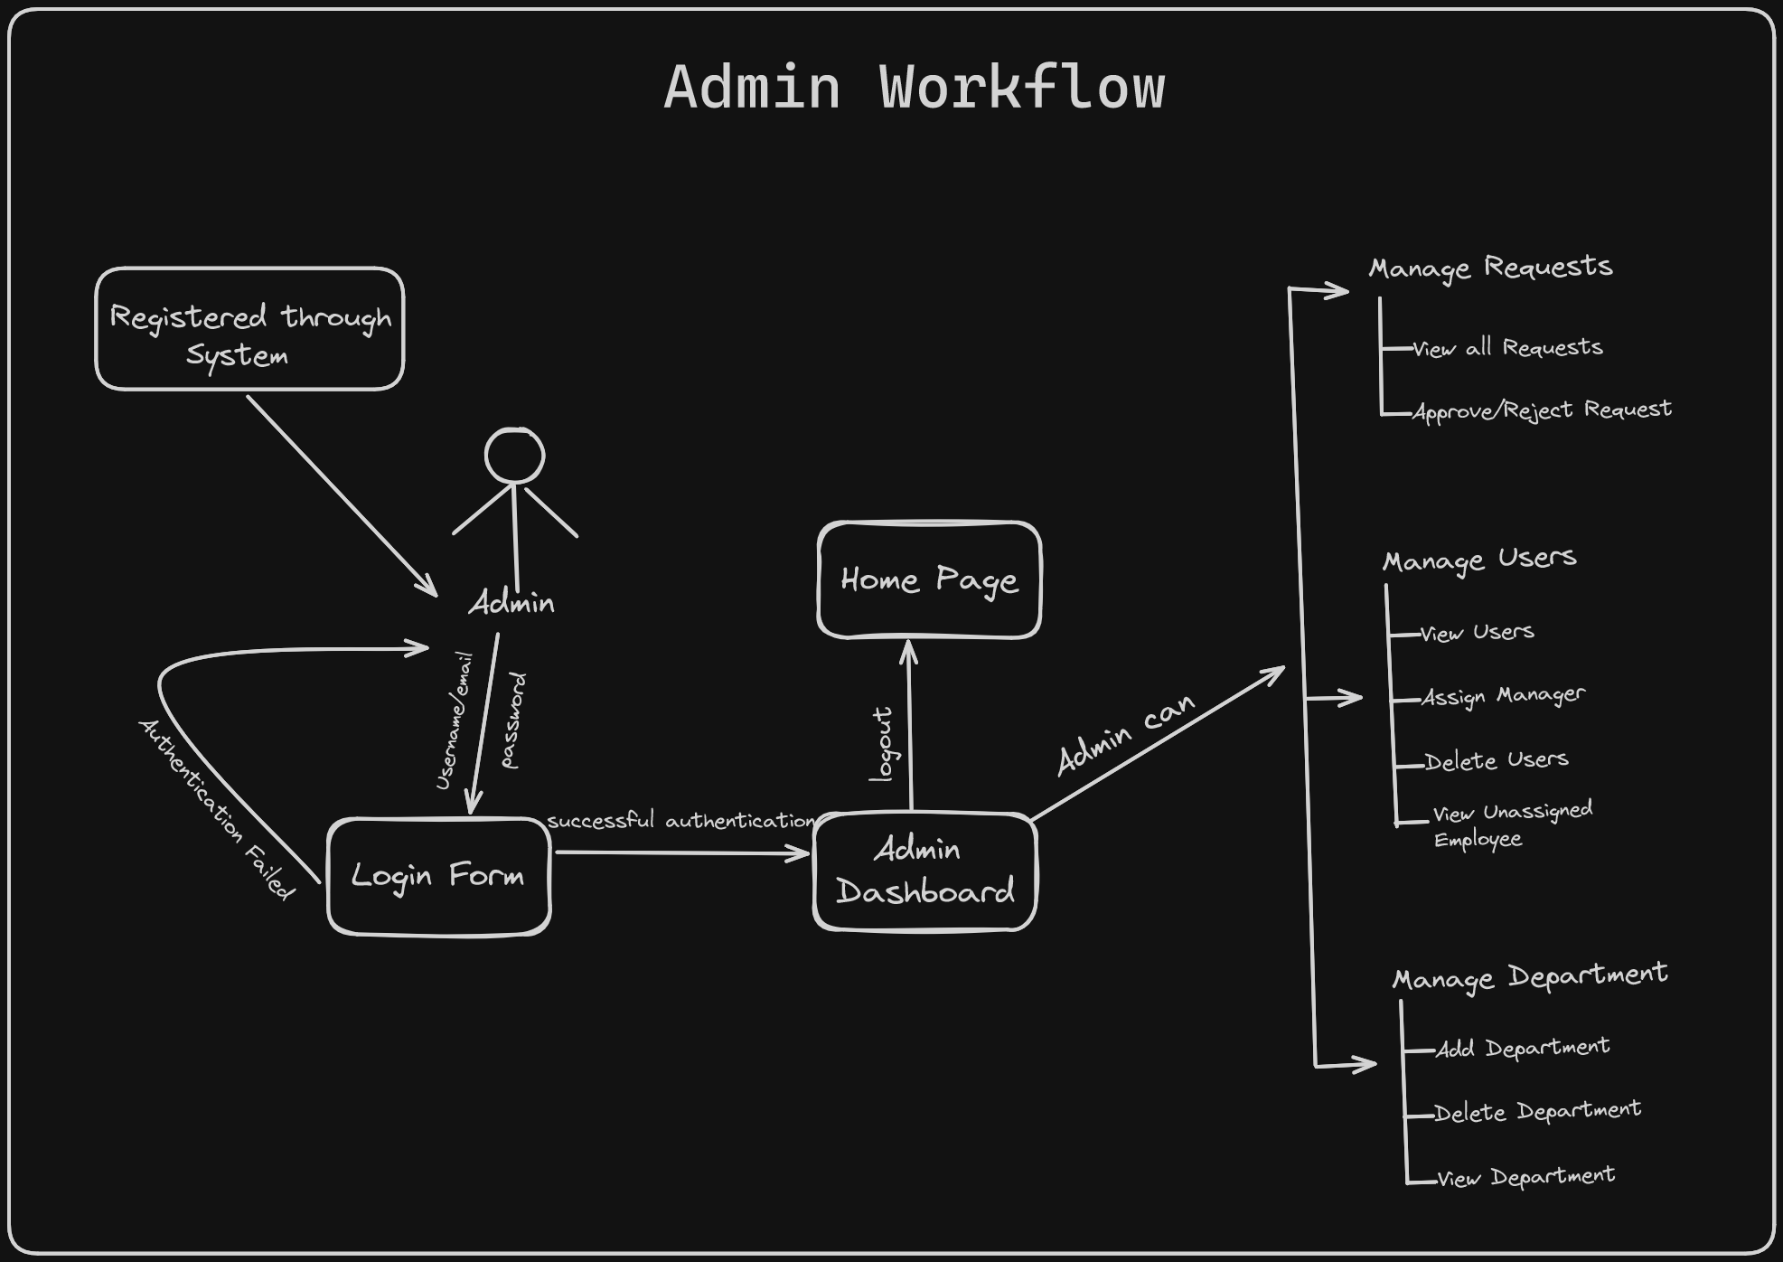

Slide 8
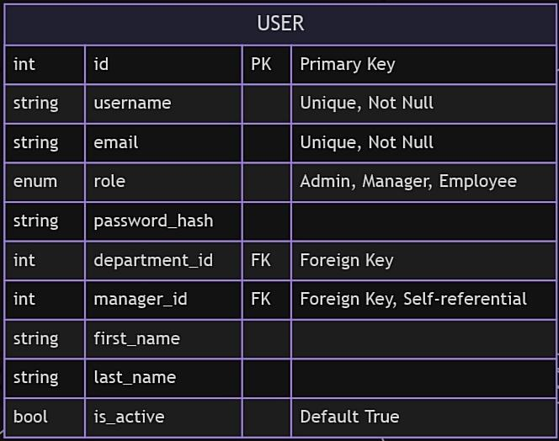
User Model

Slide 9
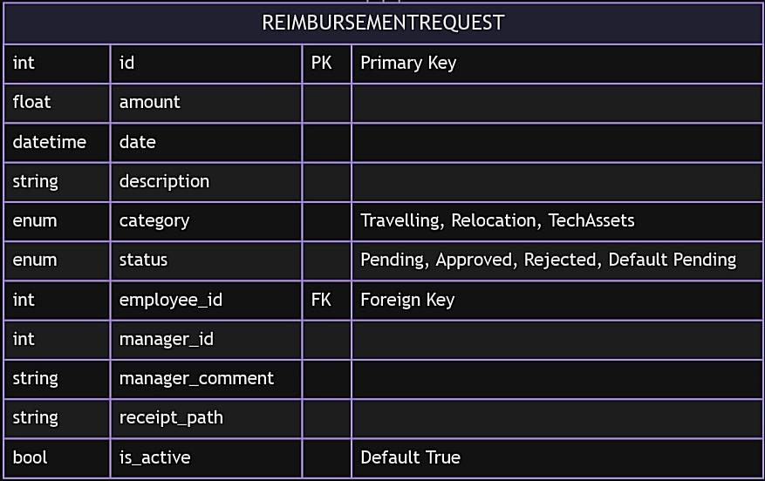
Reimbursement_request Model

Slide 10
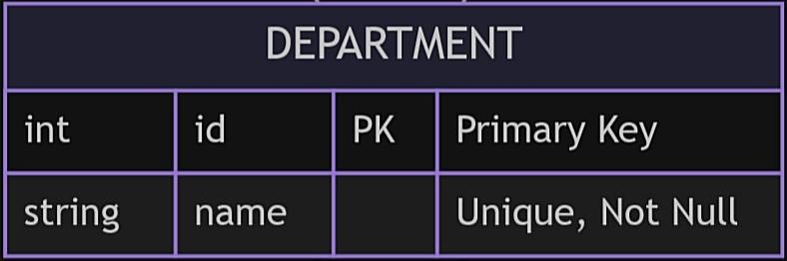
Department Model

Slide 11
Relationships
User to Department: One-to-Many
A department can have many users, but a user belongs to only one department.
User to User (Manager): One-to-Many (Self-referential)
A user (Manager) can manage many users (Employees), but an employee has only one manager.
User to ReimbursementRequest: One-to-Many
A user (Employee) can have many reimbursement requests, but a reimbursement request is linked to only one user.

Slide 12
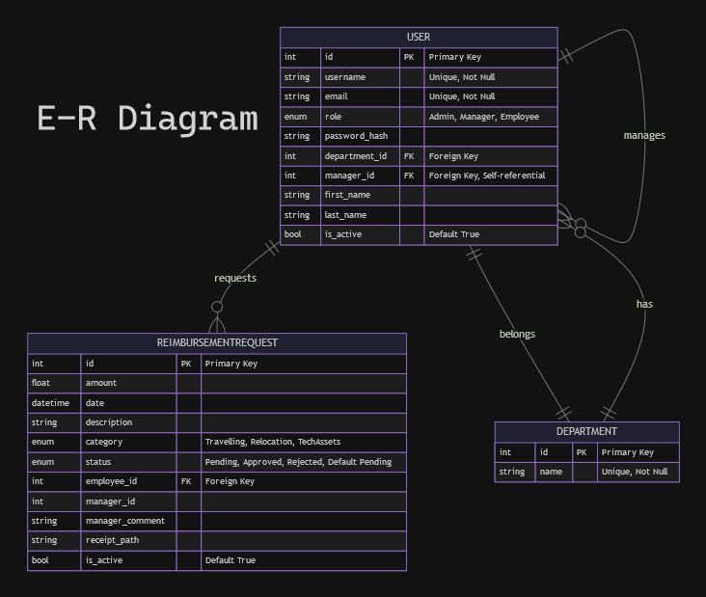

Slide 13
Technical Specification
Technologies Used:
Backend: Flask, SQLAlchemy, MySQL
Frontend: HTML, CSS, JavaScript
Tools: VSCode, UnitTest for testing
Logging module for generating application logs
UnitTest framework for testing.
Architecture:
REST API developed in Python
Database: MySQL

Slide 14
Future Enhancements
Store images in the cloud instead of the local file system.
Deployment of the project.
Make UI more attractive.
Updation of user details in UI.

Slide 15
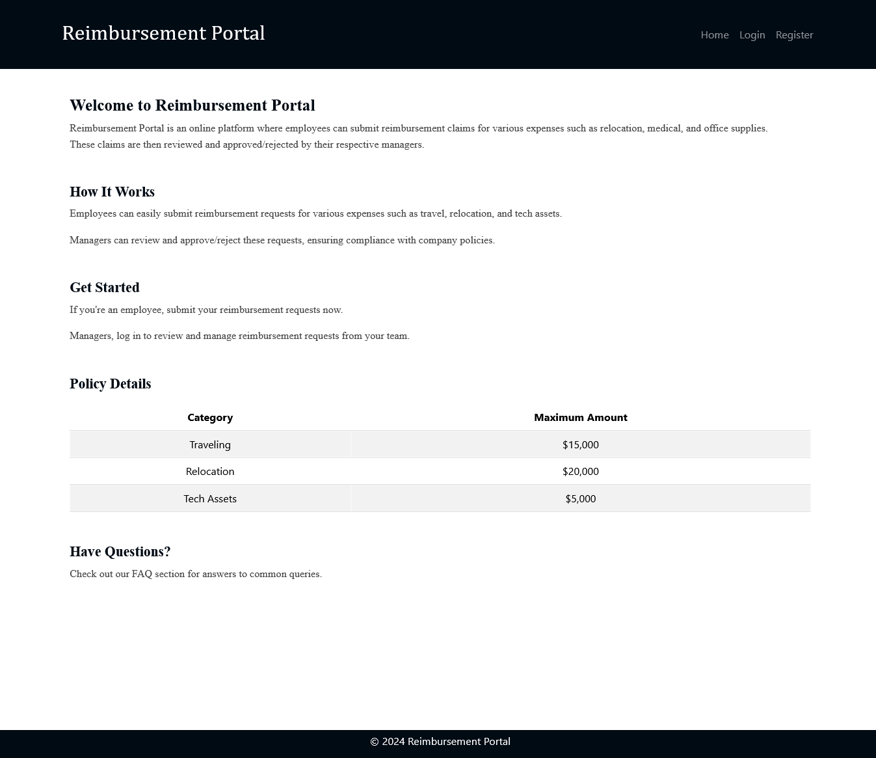
Snapshot of Home Page

Slide 16
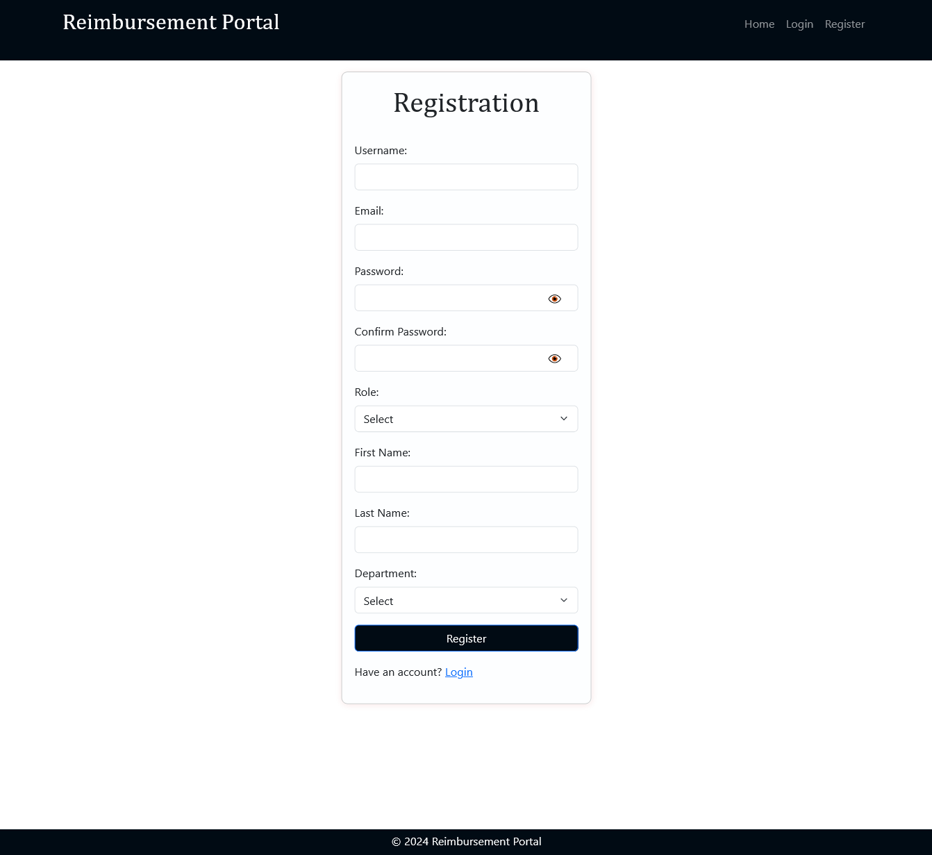
Snapshot of Registration Page

Slide 17
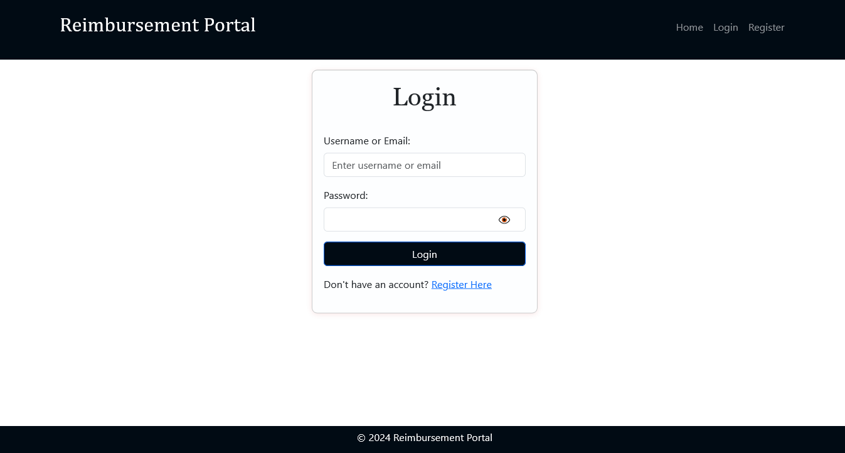
Snapshot of Login Page

Slide 18
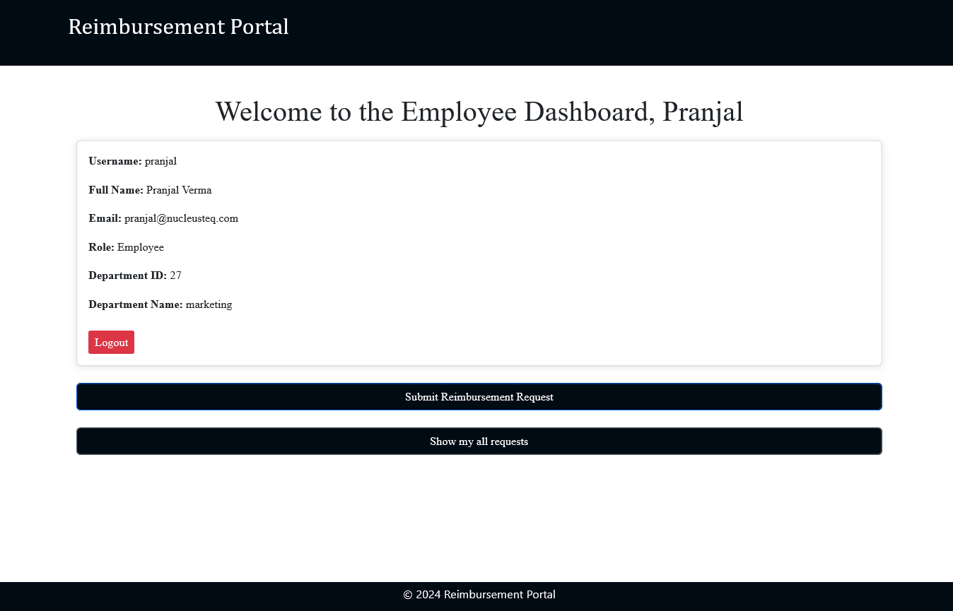
Snapshot of Employee Dashboard

Slide 19
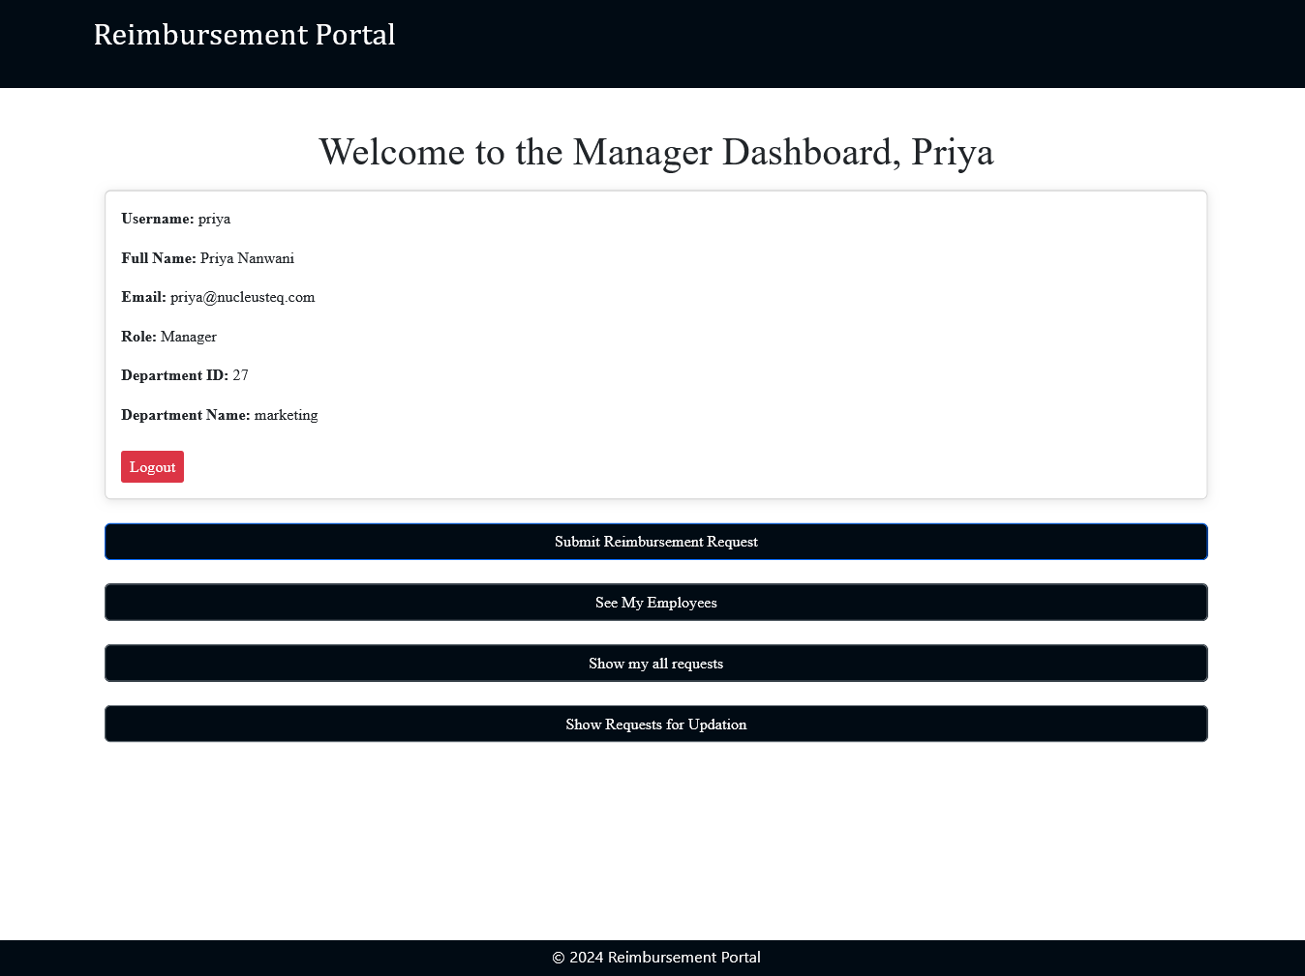
Snapshot of Manager Dashboard

Slide 20
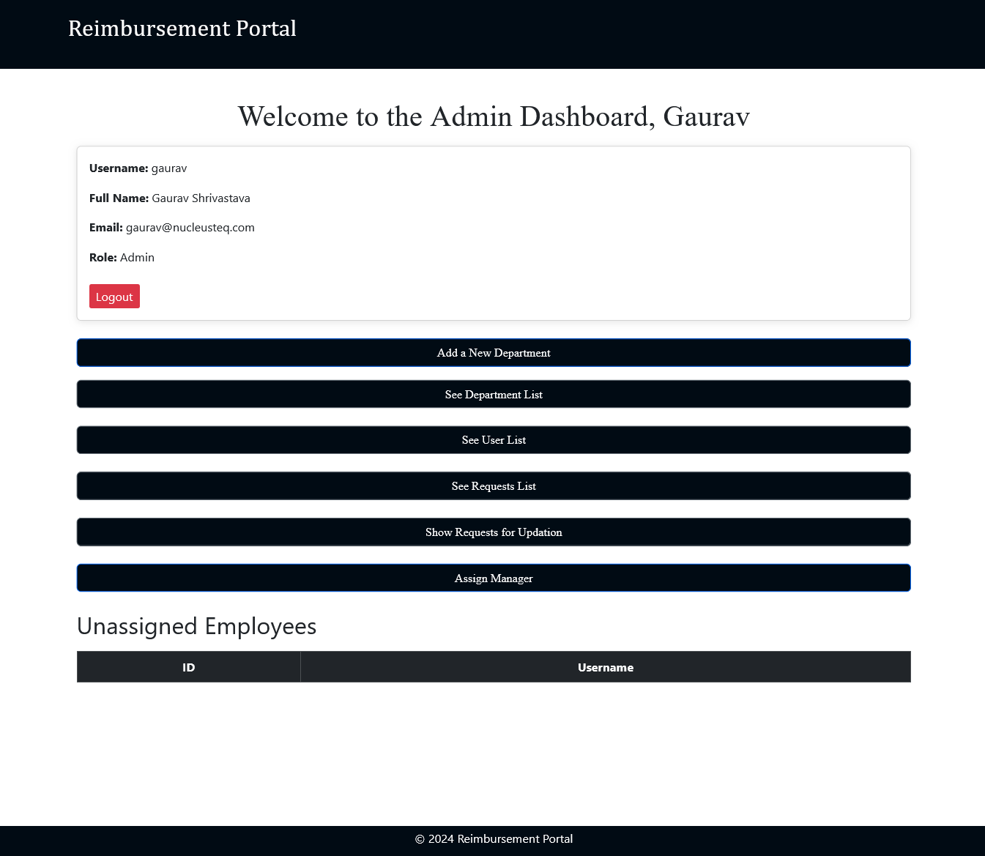
Snapshot of Admin Dashboard

Slide 21
Thank You

